Slide 1


VE450 Project
Topic: Adaptive Motor Monitoring System Based on Machine Learning Batch Training
Sponsored by Cyberinsight

Slide 2
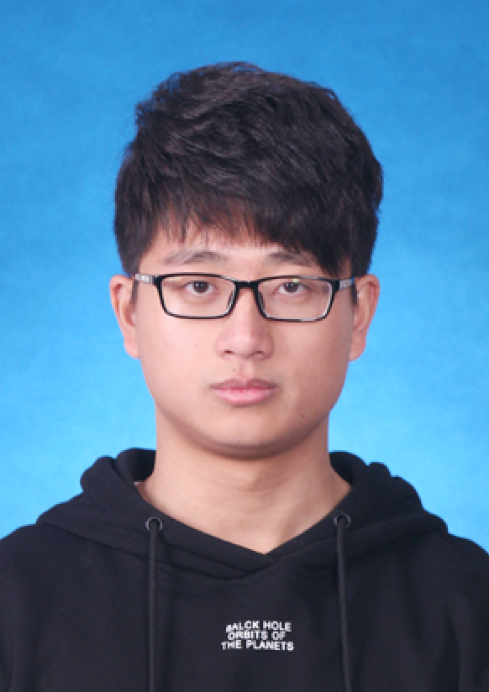
Team Leader: Ting Zhang
Background:
Project: Image recognition by using faster-rcnn
Stanford course: cs231n,cs224
Project: Participation in prediction in World Cup by machine learning
Strength:
Knowledge of machine learning
UI designing and coding
Special Skills:
Programming Language: C/C++, C#, python, lua, Matlab
Role:
Team Leader & Machine Learning Part

Slide 3

Team Member: Yiwei Cheng
Background:
JI courses: VE477(Introduction to Algorithms), VE593(Probleming solving with AI techniques)
Project: Image Processing based on Matlab; Natural Language Processing based on python
Strength:
Good ability to learn and accept new knowledge
With good team cooperation spirit
Special Skills:
Programming Language: C/C++, C#, python, Matlab
Role:
Team Member & UI designing part

Slide 4
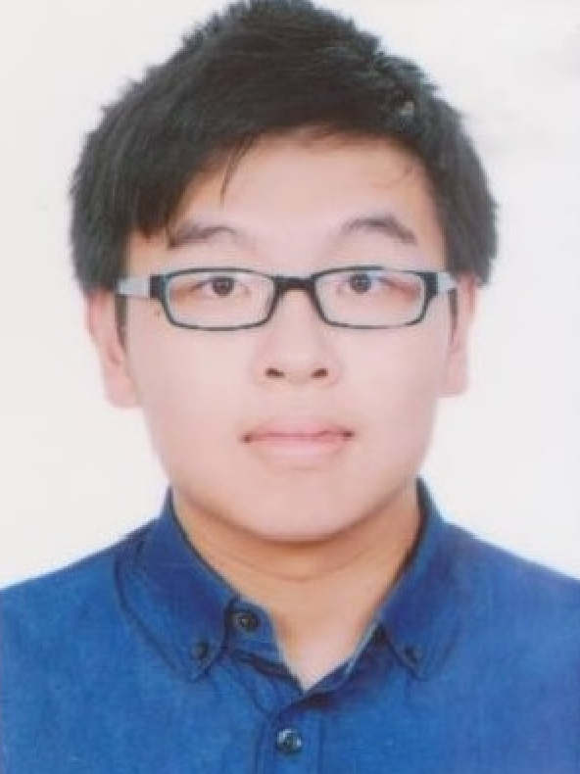
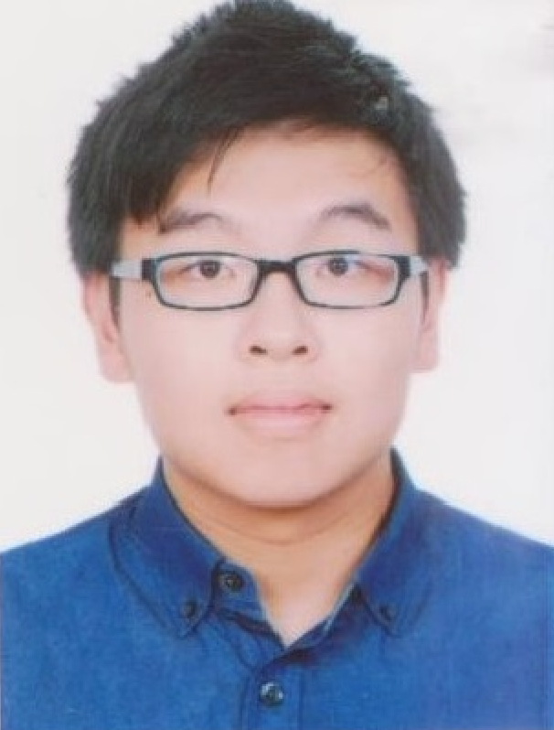
Team Member: Chenxin Zhou
Background:
Individual intern project at Synopsys including C++ programming and algorithm design
PRP project: development of Bluetooth sticker locator
Strength:
1. Coding
Special Skills:
Programming Language: C/C++, python, Matlab, LabView
Role:
Team Member & Back-end Framework Design

Slide 5
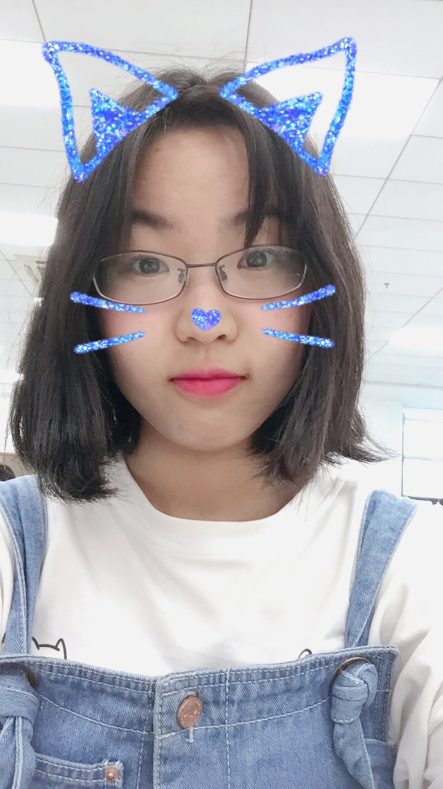
Team Member: Junru Zhu
Background: majored in ECE
PRP: Machine Learning on the Detection of Real-time Big Data Flow
IPP: Practice Research on P2P Botnet and Its Detection
Internship: YITU Tech, software testing engineer
Strength:
Testing
Special Skills:
Programming Language: C, C++
Platform: Linux, Minix
Role:
Team member & Testing & Art-related work

